Slide 1
Machine Learning CS F464
Dr. Pranav M. Pawar

Slide 2
Contents
Unsupervised Learning
Dimensionality reduction
PCA

Slide 3
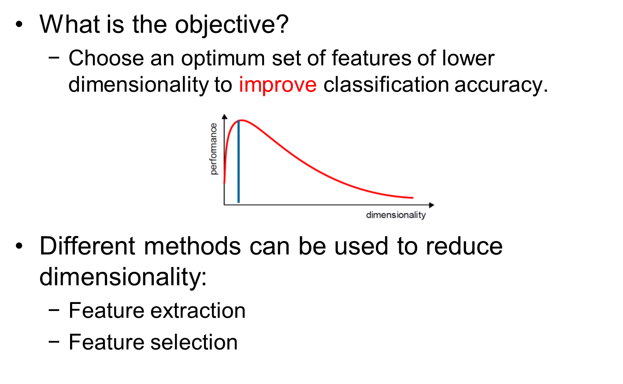
Dimensionality Reduction

Slide 4
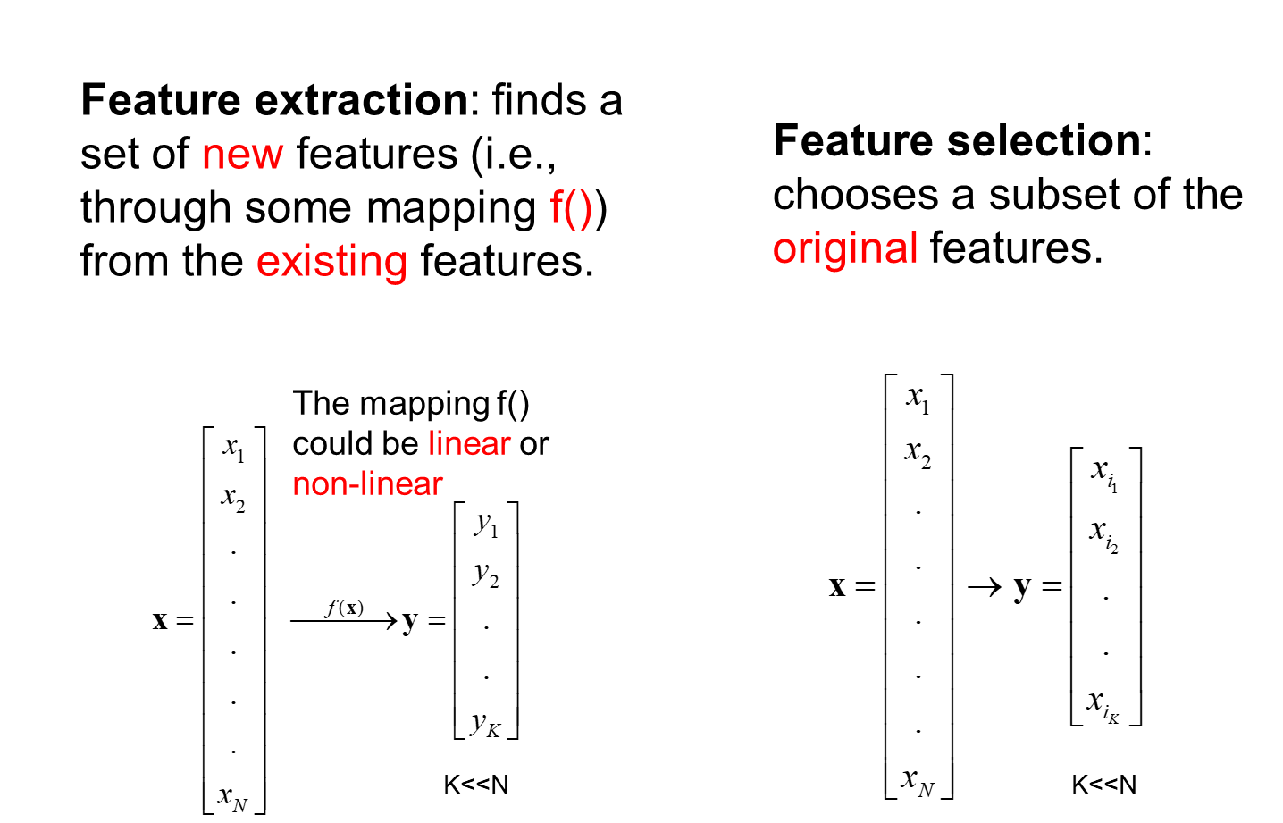
Dimensionality Reduction

Slide 5
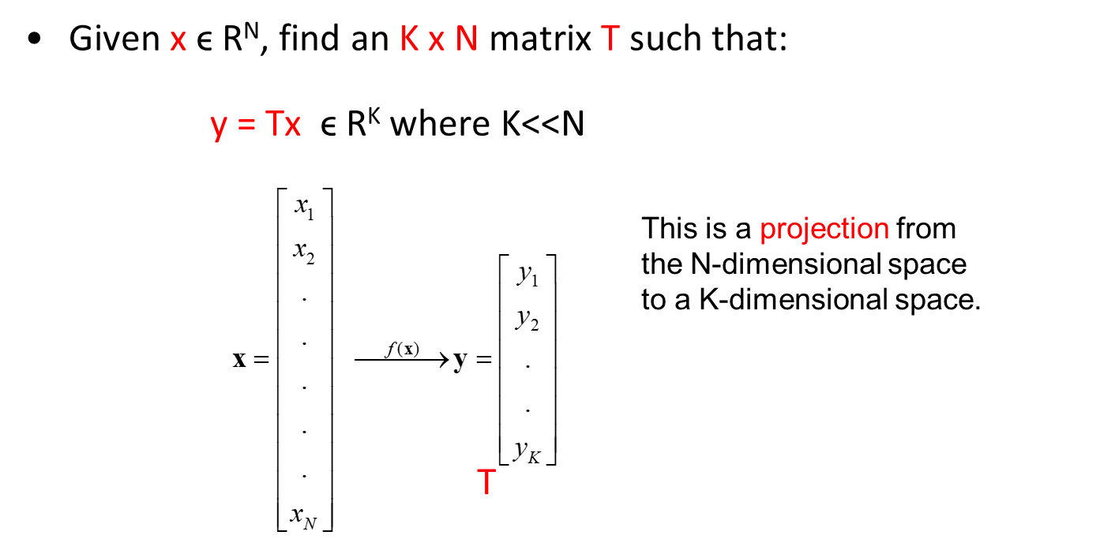
Dimensionality Reduction
Feature extraction using Linear combinations are particularly attractive because they are simpler to compute and analytically tractable.

Slide 6
Dimensionality Reduction
Popular linear feature extraction methods are:
Principal Components Analysis (PCA): Seeks a projection that preserves as much information in the data as possible.
Linear Discriminant Analysis (LDA): Seeks a projection that best discriminates the data.

Slide 7
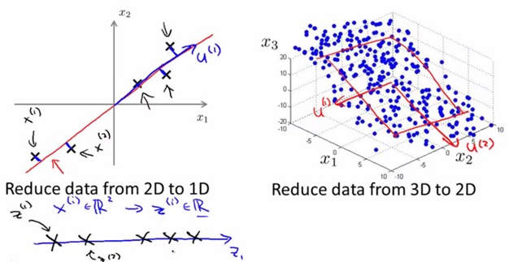
Principal Component Analysis
A well-known dimension reduction technique.
Seeks a projection that preserves as much information in the data as possible.
Transforms the variables into a new set of variables called as principal components.

Slide 8
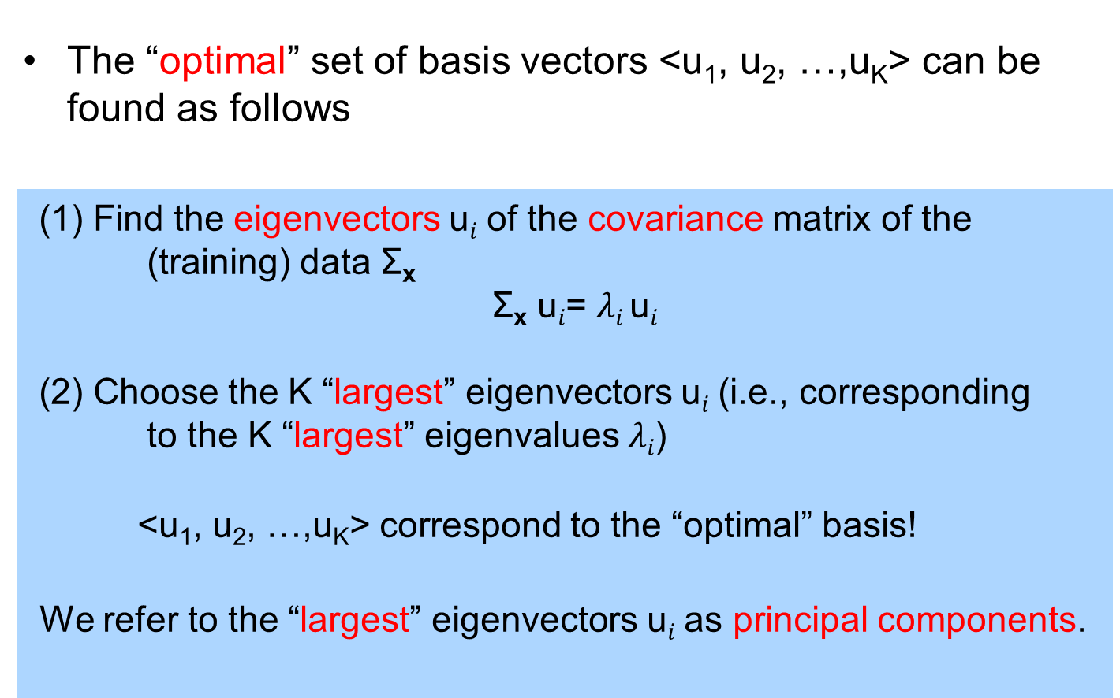
Principal Component Analysis

Slide 9
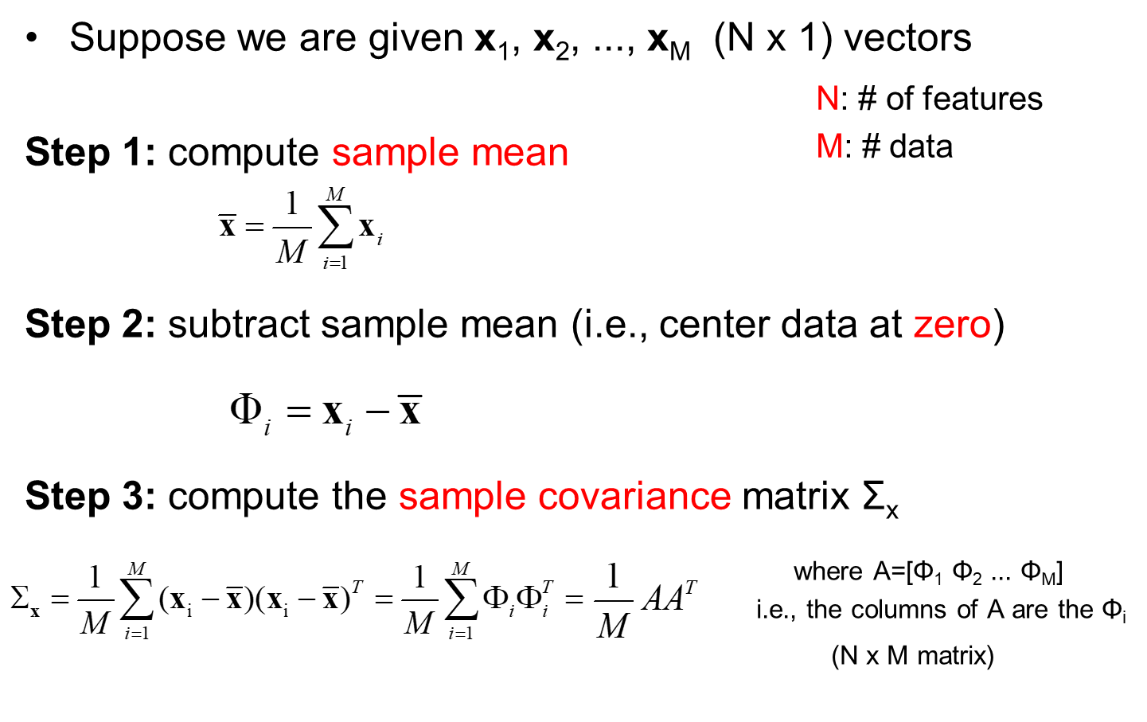
Principal Component Analysis

Slide 10
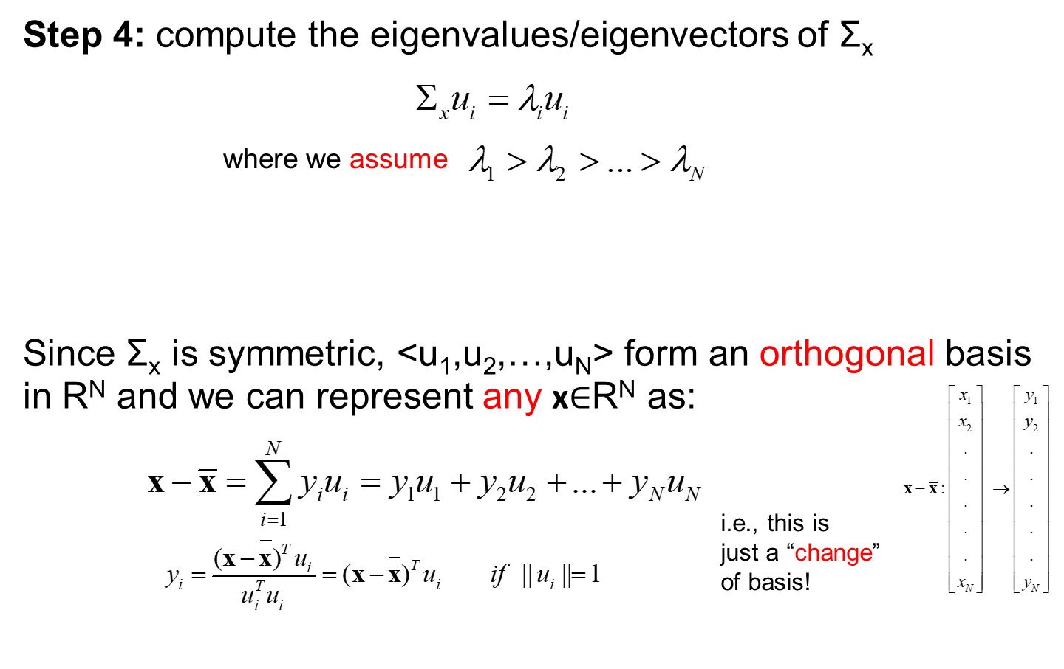
Principal Component Analysis

Slide 11
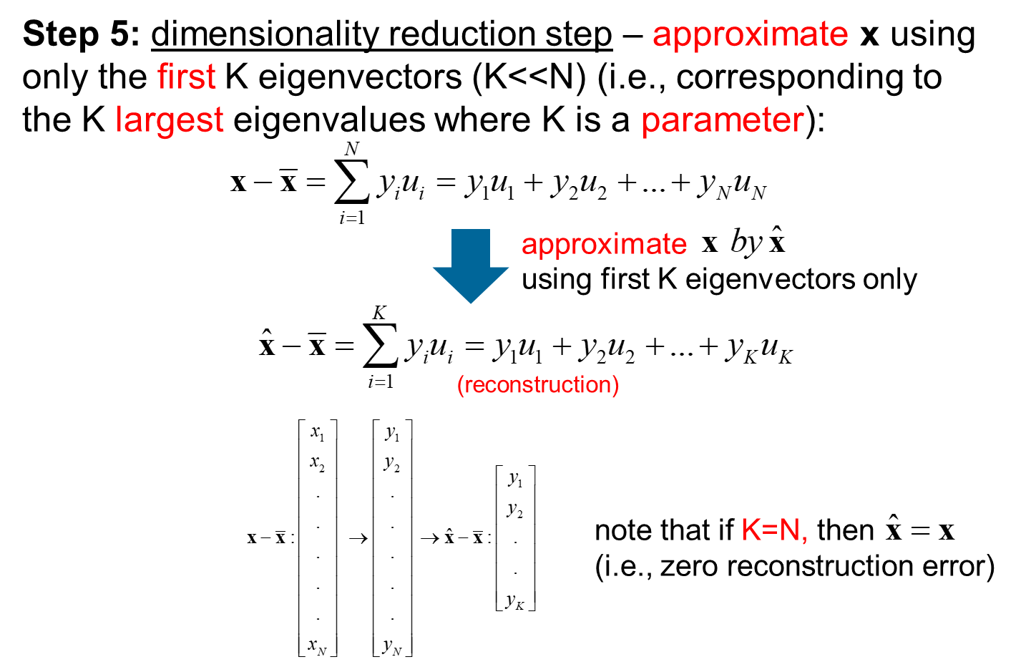
Principal Component Analysis

Slide 12
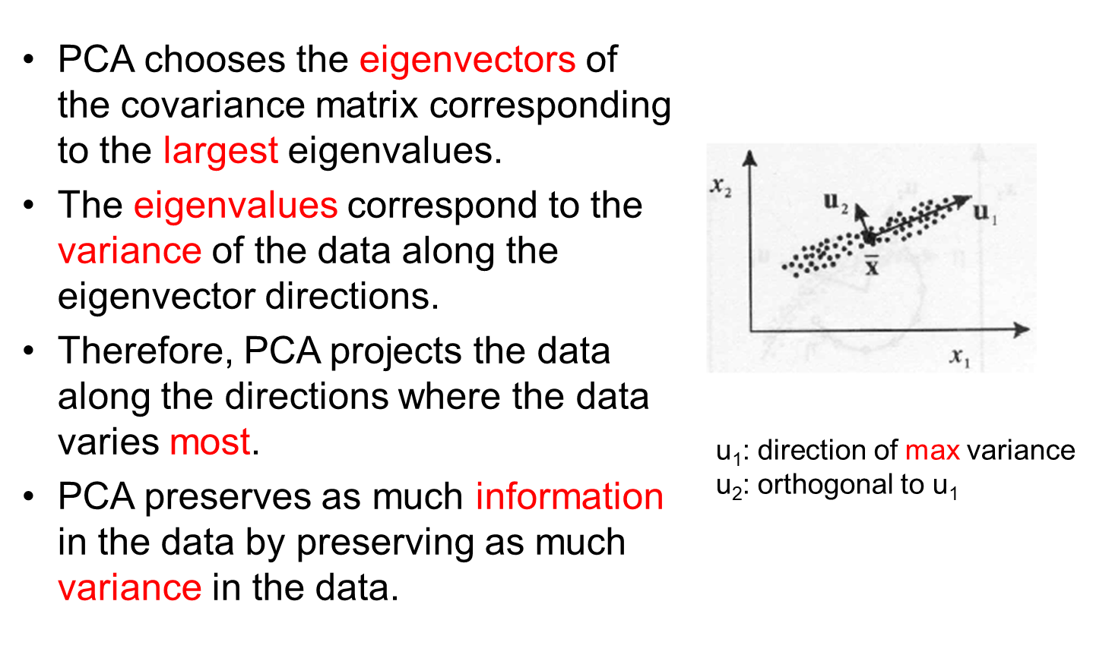
Principal Component Analysis

Slide 13
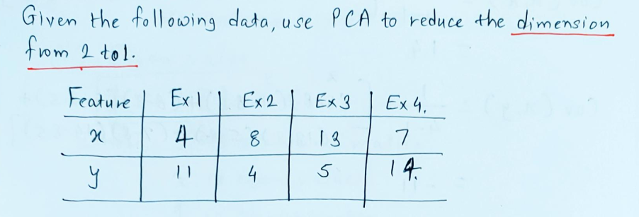
PCA Example

Slide 14
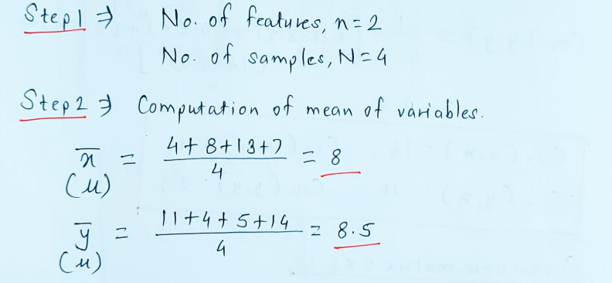

Slide 15
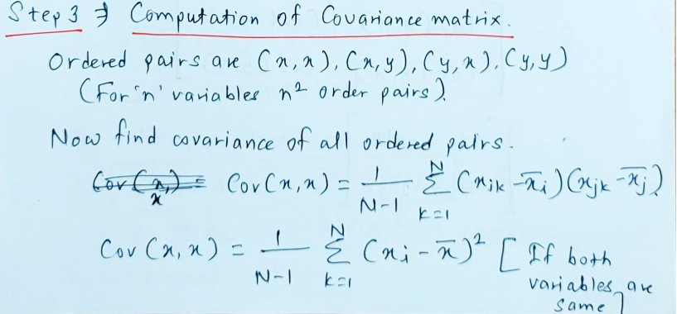
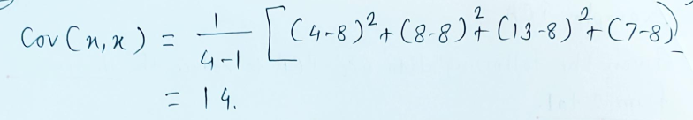

Slide 16
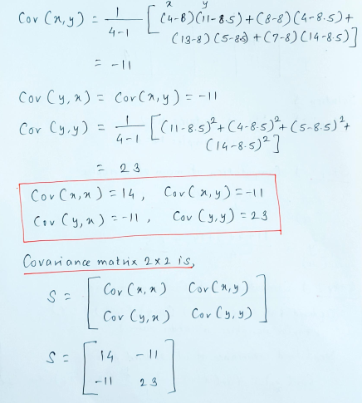

Slide 17
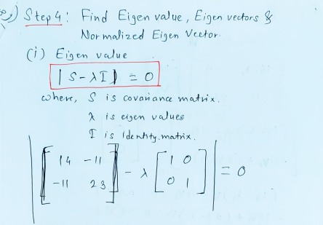

Slide 18
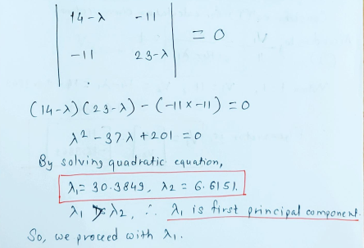

Slide 19
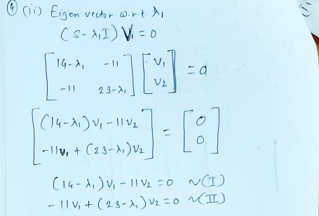

Slide 20
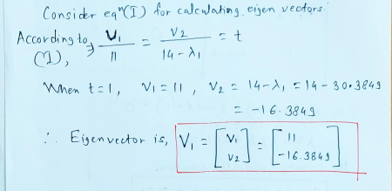

Slide 21
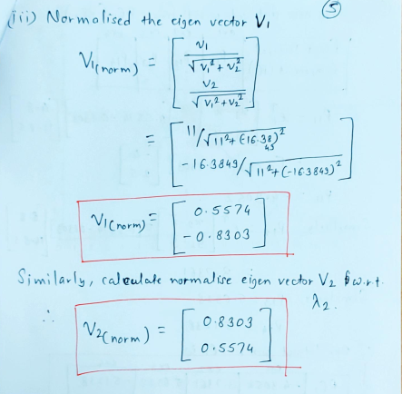

Slide 22
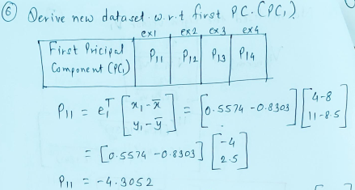

Slide 23
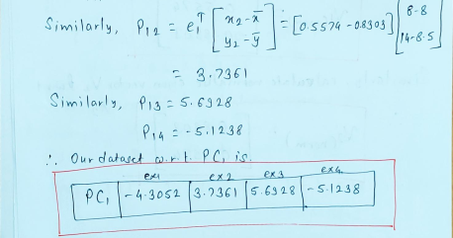

Slide 24
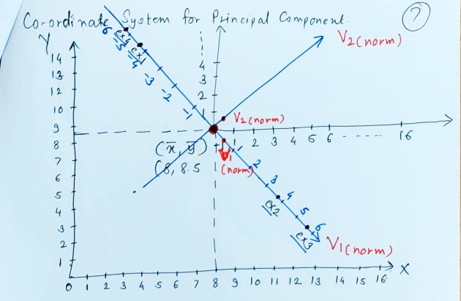

Slide 25
Sources
Chapter 9, Christopher M. Bhisop, Pattern Recognition & Machine Learning, Springer, 2006.
Chapter 6 and 14, Marsland Stephen, Machine Learning – An Algorithmic Perspective, 2e, CRC Press,2015.
Chapter 6 and 7, Alpaydin Ethem. Introduction to Machine Learning, 3e, PHI, 2014.
http://www.facweb.iitkgp.ac.in/~sudeshna/courses/ml08
https://www.cse.unr.edu/~bebis/CS479/Lectures
https://cse.iitkgp.ac.in/~dsamanta/courses/da/resources
http://www.cvip.louisville.edu/wordpress/wp-content/uploads/2010/01/LDA-Tutorial-1.pdf

Slide 26
Thank You!

